Slide 1
Parallelization of Stock Market Trading Simulation
Senior Seminar Project
Commissioned by Professor Christophre Georges
Developed by Kevin Xiao and Philip Ewing

Slide 2
Challenges
What we faced…

Slide 3
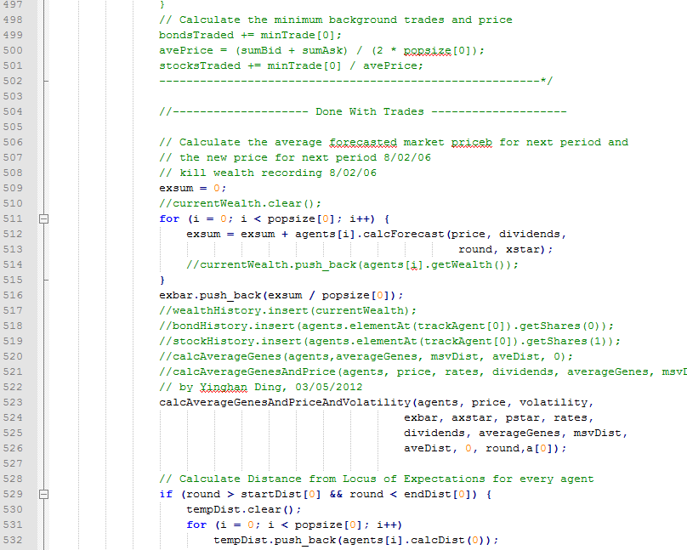
Legacy Code
Over 2500 lines of unfamiliar code (thankfully all in C++).
Assembled by disassociated parties, under various different code practices.
Many instances of non-functional code that had not been commented out.

Slide 4
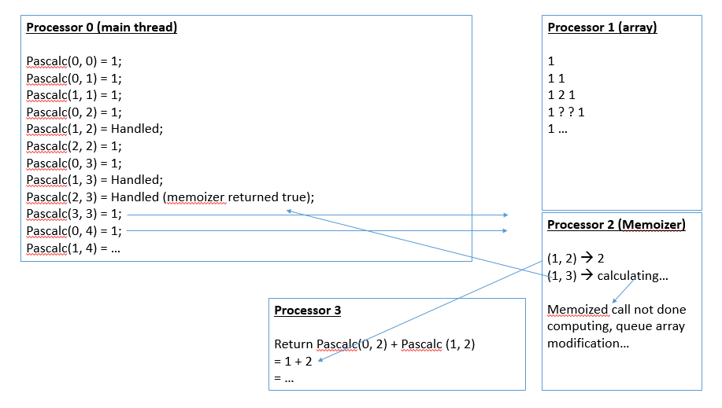
Clarifying Data Flow
How will the tasks be distributed to each processor?
What data needs to be shared between processors?
Is there information that can be prepared beforehand?

Slide 5
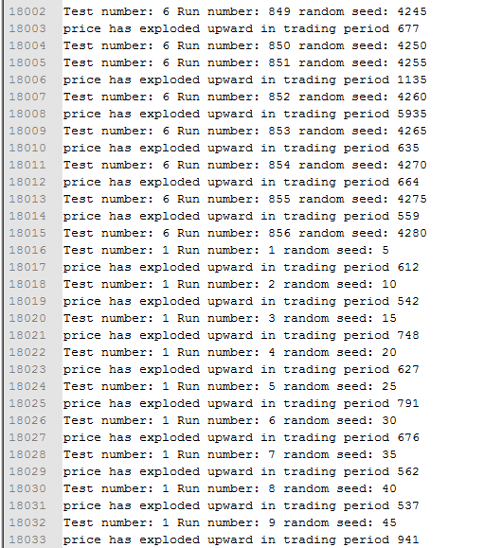
Confirming Output
All the processors create output at the same time; not necessarily in the desired order.
How do we both separate the outputs…
…and merge them back together in the desired order…
…and make sure they’re all calculated correctly?

Slide 6
Product
What we made…

Slide 7
Each processor received a copy of “driver.cpp”, which takes inputs from “input1.txt”. All of them will first initialize values shared by all processors.
Methodology
Each processor is numbered. The processors each calculate their own assigned range of task numbers and starting values, based on their processor number and the aforementioned initialized variables.
Initialize values based on “input1.txt”
Initialize values based on processor.
Each processor gets a for-loop that ‘attempts’ to run every task. However they will only execute the task if the task number falls within the aforementioned range of task numbers unique to each processor. Each processor outputs some text files which the “filecat” bash script merges into a more readable format.
Execute program once all values are initialized.

Slide 8
How we divided up work

Slide 9
Improvements
The original program would take a whole week to run 81 tests, each test containing 10000 rounds. Running it on the HPC made little difference; without parallelization, it was unable to utilize the HPC’s full potential.
Our parallelized program finishes in about 2 hours on the HPC. Same 81 tests with 10000 rounds each.

Slide 10
Roadblocks
Sharing resources – we assumed…
Lack of readable documentation on MPI errors
Changes to accessing MPI exec
Long runtime

Slide 11
Processor 0 (main thread)
Pascalc(0, 0) = 1;
Pascalc(0, 1) = 1;
Pascalc(1, 1) = 1;
Pascalc(0, 2) = 1;
Pascalc(1, 2) = Check if memoized
Processor 1 (array)
1
1 1
1 ?
Processor 2 (Memoizer)

Slide 12
Processor 0 (main thread)
Pascalc(0, 0) = 1;
Pascalc(0, 1) = 1;
Pascalc(1, 1) = 1;
Pascalc(0, 2) = 1;
Pascalc(1, 2) = Not memoized, so calculate on idle processor
Processor 1 (array)
1
1 1
1 ?
Processor 2 (Memoizer)
Return false

Slide 13
Processor 0 (main thread)
Pascalc(0, 0) = 1;
Pascalc(0, 1) = 1;
Pascalc(1, 1) = 1;
Pascalc(0, 2) = 1;
Pascalc(1, 2) = Handled;
Pascalc(2, 2) = 1;
Pascalc(0, 3) = 1;
Pascalc(1, 3) = …
Processor 1 (array)
1
1 1
1 ? 1
1 …
Processor 2 (Memoizer)
(1, 2) → calculating…
Processor 3
Return Pascalc(0, 1) + Pascalc (1, 1)
= 1 + 1
= 2

Slide 14
Processor 0 (main thread)
Pascalc(0, 0) = 1;
Pascalc(0, 1) = 1;
Pascalc(1, 1) = 1;
Pascalc(0, 2) = 1;
Pascalc(1, 2) = Handled;
Pascalc(2, 2) = 1;
Pascalc(0, 3) = 1;
Pascalc(1, 3) = Check if memoized;
Processor 1 (array)
1
1 1
1 2 1
1 ?
Processor 2 (Memoizer)
(1, 2) → 2
Processor 3
Job done!

Slide 15
Processor 0 (main thread)
Pascalc(0, 0) = 1;
Pascalc(0, 1) = 1;
Pascalc(1, 1) = 1;
Pascalc(0, 2) = 1;
Pascalc(1, 2) = Handled;
Pascalc(2, 2) = 1;
Pascalc(0, 3) = 1;
Pascalc(1, 3) = Not memoized, so calculate on idle processor
Processor 1 (array)
1
1 1
1 2 1
1 ?
Processor 2 (Memoizer)
(1, 2) → 2
Return false

Slide 16
Processor 0 (main thread)
Pascalc(0, 0) = 1;
Pascalc(0, 1) = 1;
Pascalc(1, 1) = 1;
Pascalc(0, 2) = 1;
Pascalc(1, 2) = Handled;
Pascalc(2, 2) = 1;
Pascalc(0, 3) = 1;
Pascalc(1, 3) = Handled;
Pascalc(2, 3) = Check if memorized – this will actually check (1, 3)
Processor 1 (array)
1
1 1
1 2 1
1 ? ?
Processor 2 (Memoizer)
(1, 2) → 2
(1, 3) → calculating…
Processor 3
Return Pascalc(0, 2) + Pascalc (1, 2)
= 1 + Pascalc(1, 2)
Check if memoized

Slide 17
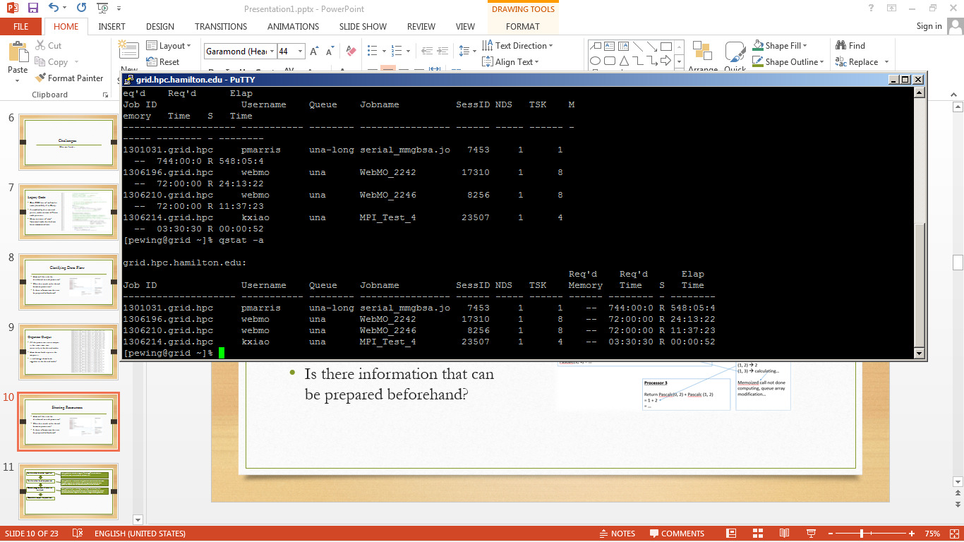
Sharing Resources
It was assumed that the HPC had enough resources for everyone’s needs.
We had to put development on-hold for two days when someone launched a hundred ~20min jobs on the HPC, preventing us from testing our program.

Slide 18
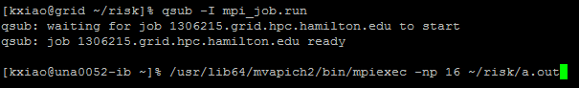
Instruction Manual
Run “removetxt.sh” (bash script) to clear leftover files from previous incomplete runs.
Adjust inputs within “input1.txt”.
Start a HPC job (consult HPC administrator for details).
Run the program with “mpiexec –np [no. of processors] [file’s location in directory]”.
Note that it’s pointless to assign more processors than tasks available.
When it’s finished, run “filecat [no. of processors]” (bash script) to merge each processor’s output.

Slide 19
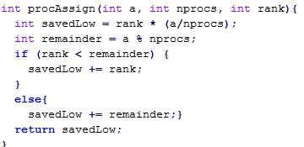
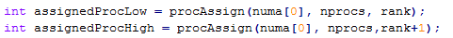
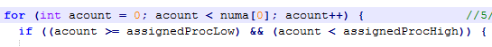
Support for Variable Processors
a (total tasks) | nprocs (total procs) | rank (proc no.) |  | savedLow | remainder | return |  | assignedRange
81 | 16 | 0 |  | 0 | 1 | 0 |  | 0-5
81 | 16 | 1 |  | 5 | 1 | 6 |  | 6-10
81 | 16 | 2 |  | 10 | 1 | 11 |  | 11-15
81 | 16 | 3 |  | 15 | 1 | 16 |  | 16-20
81 | 16 | 4 |  | 20 | 1 | 21 |  | 21-25
81 | 16 | 5 |  | 25 | 1 | 26 |  | 26-30
81 | 16 | 6 |  | 30 | 1 | 31 |  | 31-35
81 | 16 | 7 |  | 35 | 1 | 36 |  | 36-40
81 | 16 | 8 |  | 40 | 1 | 41 |  | 41-45
81 | 16 | 9 |  | 45 | 1 | 46 |  | 46-50
81 | 16 | 10 |  | 50 | 1 | 51 |  | 51-55
81 | 16 | 11 |  | 55 | 1 | 56 |  | 56-60
81 | 16 | 12 |  | 60 | 1 | 61 |  | 61-65
81 | 16 | 13 |  | 65 | 1 | 66 |  | 66-70
81 | 16 | 14 |  | 70 | 1 | 71 |  | 71-75
81 | 16 | 15 |  | 75 | 1 | 76 |  | 76-80

Slide 20
Programming for Multiple Processors
Need to keep track of a processor’s number or ID – stored as an “int”.
Remember that the processors are working simultaneously and out-of-sync.
When sending information to another processor, the other processor must be ready to receive that information.
The program will fail if a processor sends information to a processor which is not ready to receive, or if the information sent is not of the expected kind (e.g. type mismatch, size mismatch, wrong processor ID, etc.)

Slide 21
Processor 0 (main thread)
Pascalc(0, 0) = 1;
Pascalc(0, 1) = 1;
Pascalc(1, 1) = 1;
Pascalc(0, 2) = 1;
Pascalc(1, 2) = Handled;
Pascalc(2, 2) = 1;
Pascalc(0, 3) = 1;
Pascalc(1, 3) = Handled;
Pascalc(2, 3) = Handled (memoizer returned true);
Pascalc(3, 3) = 1;
Pascalc(0, 4) = 1;
Pascalc(1, 4) = …
Processor 1 (array)
1
1 1
1 2 1
1 ? ? 1
1 …
Processor 2 (Memoizer)
(1, 2) → 2
(1, 3) → calculating…
Memoized call not done computing, queue array modification…
Processor 3
Return Pascalc(0, 2) + Pascalc (1, 2)
= 1 + 2
= …

Slide 22
Processor 0 (main thread)
Pascalc(0, 0) = 1;
Pascalc(0, 1) = 1;
Pascalc(1, 1) = 1;
Pascalc(0, 2) = 1;
Pascalc(1, 2) = Handled;
Pascalc(2, 2) = 1;
Pascalc(0, 3) = 1;
Pascalc(1, 3) = Handled;
Pascalc(2, 3) = Handled (memoizer returned true);
Pascalc(3, 3) = 1;
Pascalc(0, 4) = 1;
Pascalc(1, 4) = …
Processor 1 (array)
1
1 1
1 2 1
1 ? ? 1
1 …
Processor 2 (Memoizer)
(1, 2) → 2
(1, 3) → calculating…
Memoized call not done computing, queue array modification…
Processor 3
Return Pascalc(0, 2) + Pascalc (1, 2)
= 1 + 2
= 3

Slide 23
Processor 0 (main thread)
Pascalc(0, 0) = 1;
Pascalc(0, 1) = 1;
Pascalc(1, 1) = 1;
Pascalc(0, 2) = 1;
Pascalc(1, 2) = Handled;
Pascalc(2, 2) = 1;
Pascalc(0, 3) = 1;
Pascalc(1, 3) = Handled;
Pascalc(2, 3) = Handled (memoizer returned true);
Pascalc(3, 3) = 1;
Pascalc(0, 4) = 1;
Pascalc(1, 4) = …
Processor 1 (array)
1
1 1
1 2 1
1 3 ? 1
1 …
Processor 2 (Memoizer)
(1, 2) → 2
(1, 3) → 3
Processor 3
Job done!

Slide 24
Processor 0 (main thread)
Pascalc(0, 0) = 1;
Pascalc(0, 1) = 1;
Pascalc(1, 1) = 1;
Pascalc(0, 2) = 1;
Pascalc(1, 2) = Handled;
Pascalc(2, 2) = 1;
Pascalc(0, 3) = 1;
Pascalc(1, 3) = Handled;
Pascalc(2, 3) = Handled (memoizer returned true);
Pascalc(3, 3) = 1;
Pascalc(0, 4) = 1;
Pascalc(1, 4) = …
Processor 1 (array)
1
1 1
1 2 1
1 3 3 1
1 …
Processor 2 (Memoizer)
(1, 2) → 2
(1, 3) → 3

